Slide 1
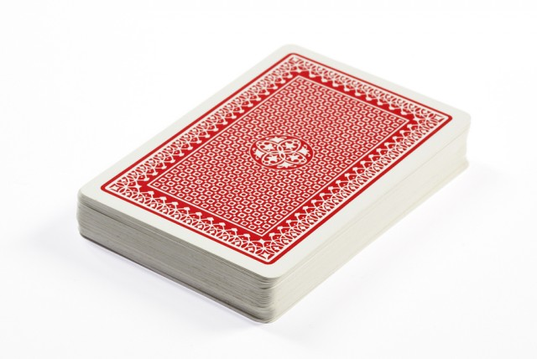
5 Card Poker
Brandon Lee

Slide 2
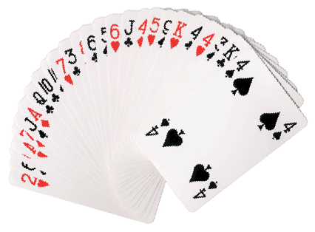
What is it?
One of the most common variants of the Poker card game
Pretty simple and easy to learn compared to other versions

Slide 3
How to Play
Deck is shuffled by dealer and cards are distributed
Each player starts with 5 cards in their hand
Players look at their cards and determine if they want to redraw up to 5 cards
The redraws take place
Players reveal their hands and the player with the highest hand wins

Slide 4
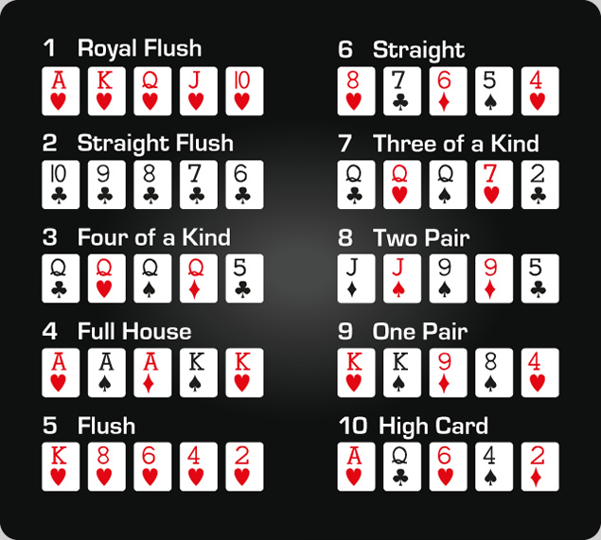
Types of hands

Slide 5
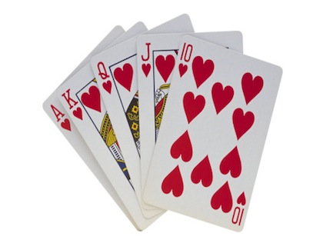
Project Features
1-4 players
Possible simple AI fill any empty player spaces
Possibly a betting system

Slide 6
Image Sources
http://www.pokerharder.com/uk/learn-poker/hand-rankings/
http://cbsnewyork.files.wordpress.com/
http://fitnowtraining.com/
http://www.allworship.com/wp-content/uploads/

